Slide 1

Robo Review Project
by Alvaro Lacave

Slide 2
What have we done?
Review Classification
Product Category Clustering
Review Summarization Using Generative AI
We combine 3 different models for this task Using thousands of Amazon reviews.

Slide 3
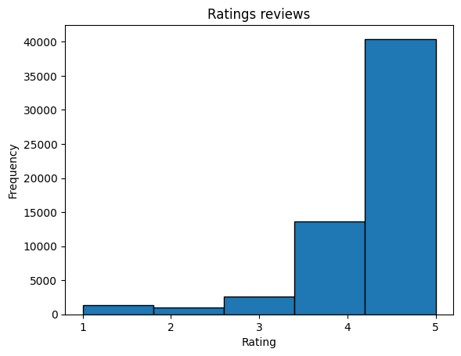
Part 0: Data Preprocessing
Consumer Reviews of Amazon Products
It was a really imbalanced Dataset Many 5 ratings

Slide 4
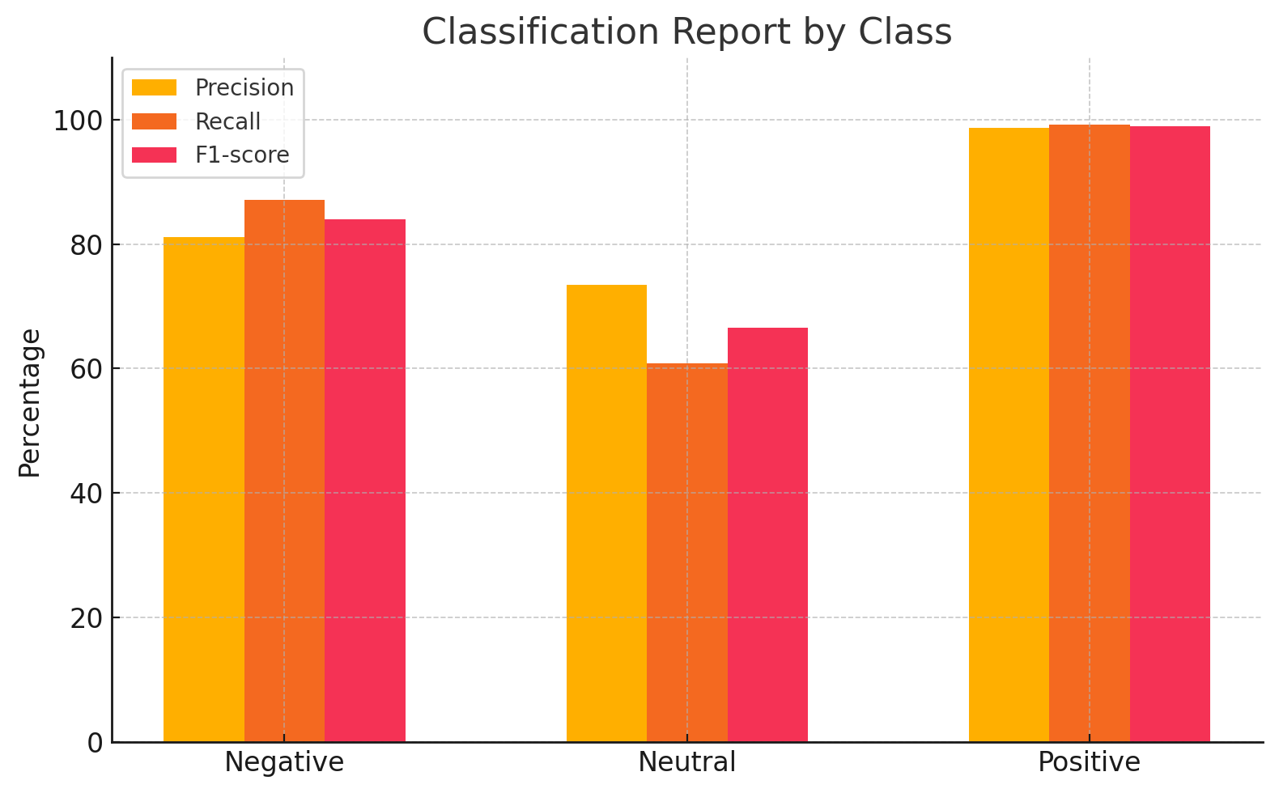
Part 1 - Review Classification
DistilBERT-base-uncased
Map sentiment based on rating:
1-2 stars → Negative
3 stars → Neutral
4-5 stars → Positive

Slide 5
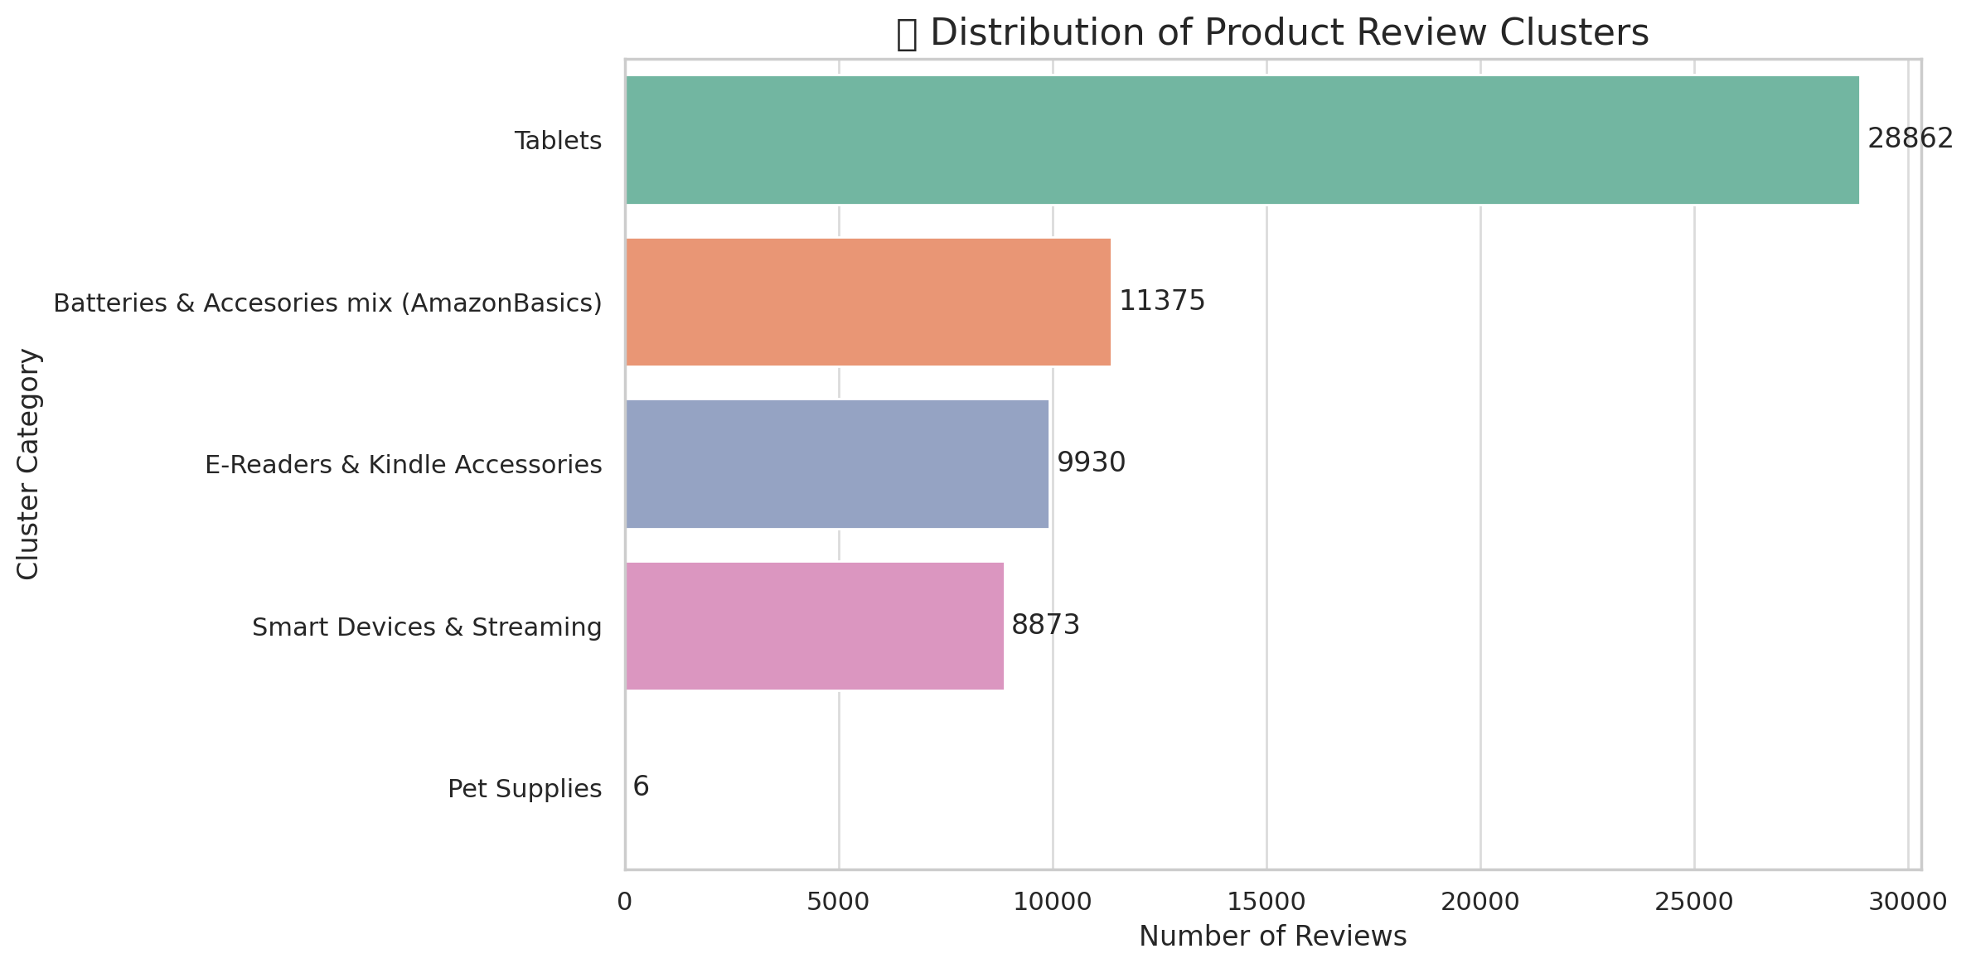
Part 2 - Product Category Clustering
- Objective:
Simplify the dataset by clustering product categories into 4-6 meta-categories.
Total Unique Categories: 97
BERT-Based Sentence Embeddings (sentence-transformers/all-MiniLM-L6-v2) that apply K-Means for grouping.
Optimal number of clusters using Elbow Method was 5.
I had to do some manual reassignments

Slide 6
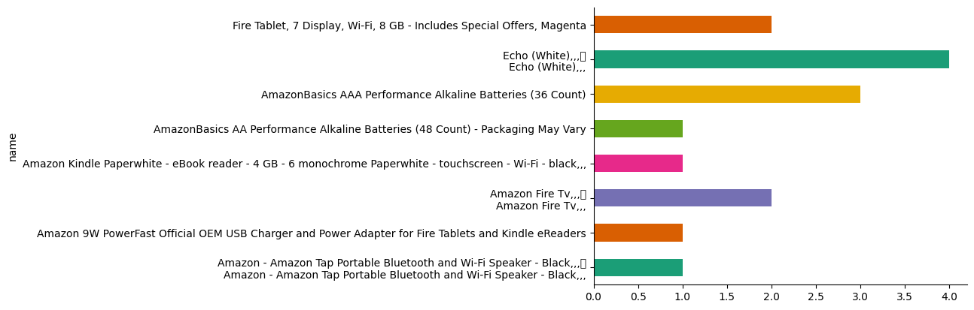
Part 3- Review summarization using Generative AI
Data Preparation : Merge both datasets
IDentify top and worst products

Slide 7
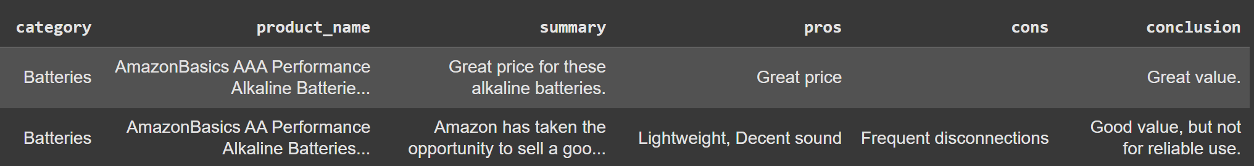
Part 3- Review summarization using Generative AI
3) Review Summartization using model "mistralai/Mistral-7B-v0.3" using 4-bit quantization - Zero- shot promp, few shots promp - Generated structured JSON
4) Summarizing all products

Slide 8
Article Generation
You are a helpful assistant. Write a short article recommending products in the "Ebook readers & Tablets" category based on user reviews.
The article should include:
- The main pros and complaints for each of the top 3 products
- A warning about the worst-rated product and why it should be avoided

Slide 9
### Top Products:
1. Amazon Kindle Paperwhite - eBook reader - 4 GB - 6 monochrome Paperwhite - touchscreen - Wi-Fi - black,,,
Summary: Great for what it's meant to be
Pros: Light, Backlight, Easy to operate
Cons:
Conclusion: Great value

Slide 10
### Worst Product:
- Amazon - Kindle Voyage - 4GB - Wi-Fi + 3G - Black,,,
Fire HD 8 Tablet with Alexa, 8 HD Display, 16 GB, Tangerine - with Special Offers",
Summary: To many ads. Its ok for the price if willing to deal with the ads and cant download certain apps.
Main Issues: To many ads, Its ok for the price if willing to deal with the ads and cant download certain apps
Conclusion: Not worth the price.

Slide 11
### The Top 3 Ebook Readers and Tablets: Article
The Amazon Kindle Paperwhite is a great choice for an ebook reader. It has a 6-inch touchscreen display, 4 GB of storage, and Wi-Fi connectivity. It also has a backlight, making it easy to read in low-light conditions. The main complaints about the Kindle Paperwhite are that it doesn't have a front-facing camera and that it's not as durable as other ebook readers.
The Fire Tablet is a great choice for a tablet. It has a 7-inch display, front and rear-facing cameras, and Wi-Fi connectivity. It also has a nice interface and is fairly snappy. The main complaints about the Fire Tablet are that it's not as durable as other tablets and that it has frequent disconnections.
The Echo is a great choice for a tablet. It has a 7-inch display, front and rear-facing cameras, and Wi-Fi connectivity. It also has a nice interface and is fairly snappy. The main complaints about the Echo are that it's not as durable as other tablets and that it has frequent disconnections.
### The Worst-Rated Product
The Amazon Kindle Voyage is the worst-rated product in this category. It has a 6-inch touchscreen display, 4 GB of storage, and Wi-Fi connectivity.

Slide 12
Takeway.
Big challenge
structure 3 different tasks for one main goal
it is essential to prepare Data good enough

